Slide 1
Brazilian OLIST E-Commerce Analysis
Presented by Jamie

Slide 2
Objectives
Analyze business operations of OLIST E-commerce platform
Analyze user behavior & customer satisfaction
Identify potential problems & propose solutions
Provide insights & make suggestions

Slide 3
Analysis Process
Data
Processing
Data Visualization
Data
Interpretation
Insight
&
Suggestion

Slide 4
Dataset Schema
Data Source: Kaggle
Product
Category
Payment
Product
product_category_name
order_id
product_id
Reviews
order_id
Order
order_id
Order Item
seller_id
Seller
customer_id
zip_code_prefix
Geolocation
Customer

Slide 5
Variables Explanations
Variable Name | Meaning | Variables | Meaning
order_id | unique identifier of the order | customer_state | customer state name
item_sequence | sequential number identifying number of items included in the same order | customer_city | customer city name
product_id | product unique identifier | geolocation_lat | latitude
price | item price | geolocation_lng | longitude
seller_id | seller unique identifier | geolocation_city | city name
customer_id | key to the orders dataset Each order has a unique customer_id. | geolocation_state | state
customer_unique_id | unique identifier of a customer. | seller_id | seller unique identifier
zip_code_prefix | first 5 digits of zip code

Slide 6
Variables Explanations
Variables | Meaning
order_status | reference to the order status (delivered, shipped, etc)
order_purchase_timestamp | purchase timestamp
order_approved_at | payment approval timestamp
order_delivered_carrier_date | when it was handled to the logistic partner
order_delivered_customer_date | actual order delivery date to the customer.
delivery_day | (order_delivered_customer_date) – (order_delivered_carrier_date)
product_category_name_english | category name in English
review_score | note ranging from 1 to 5 given by the customer on a satisfaction survey
review_comment_title | comment title from the review left by the customer, in Portuguese

Slide 7
Data Processing
Null value: [order_approved_at, order_delivered_carrier_date, order_delivered_customer_date, delivery day] ➞ Payment not approved, Orders not delivered [product_category_name_english] ➞ products not categorized [review_score, review_comment_title] ➞ customers did not leave reviews score or comments
Drop cancelled & unavailable orders
Drop monthly data, which has null value ➞ 2018-09 (just 1 order)
Drop duplicate values ➞ duplicate reviews in one order
Change the data type ➞ datetime

Slide 8
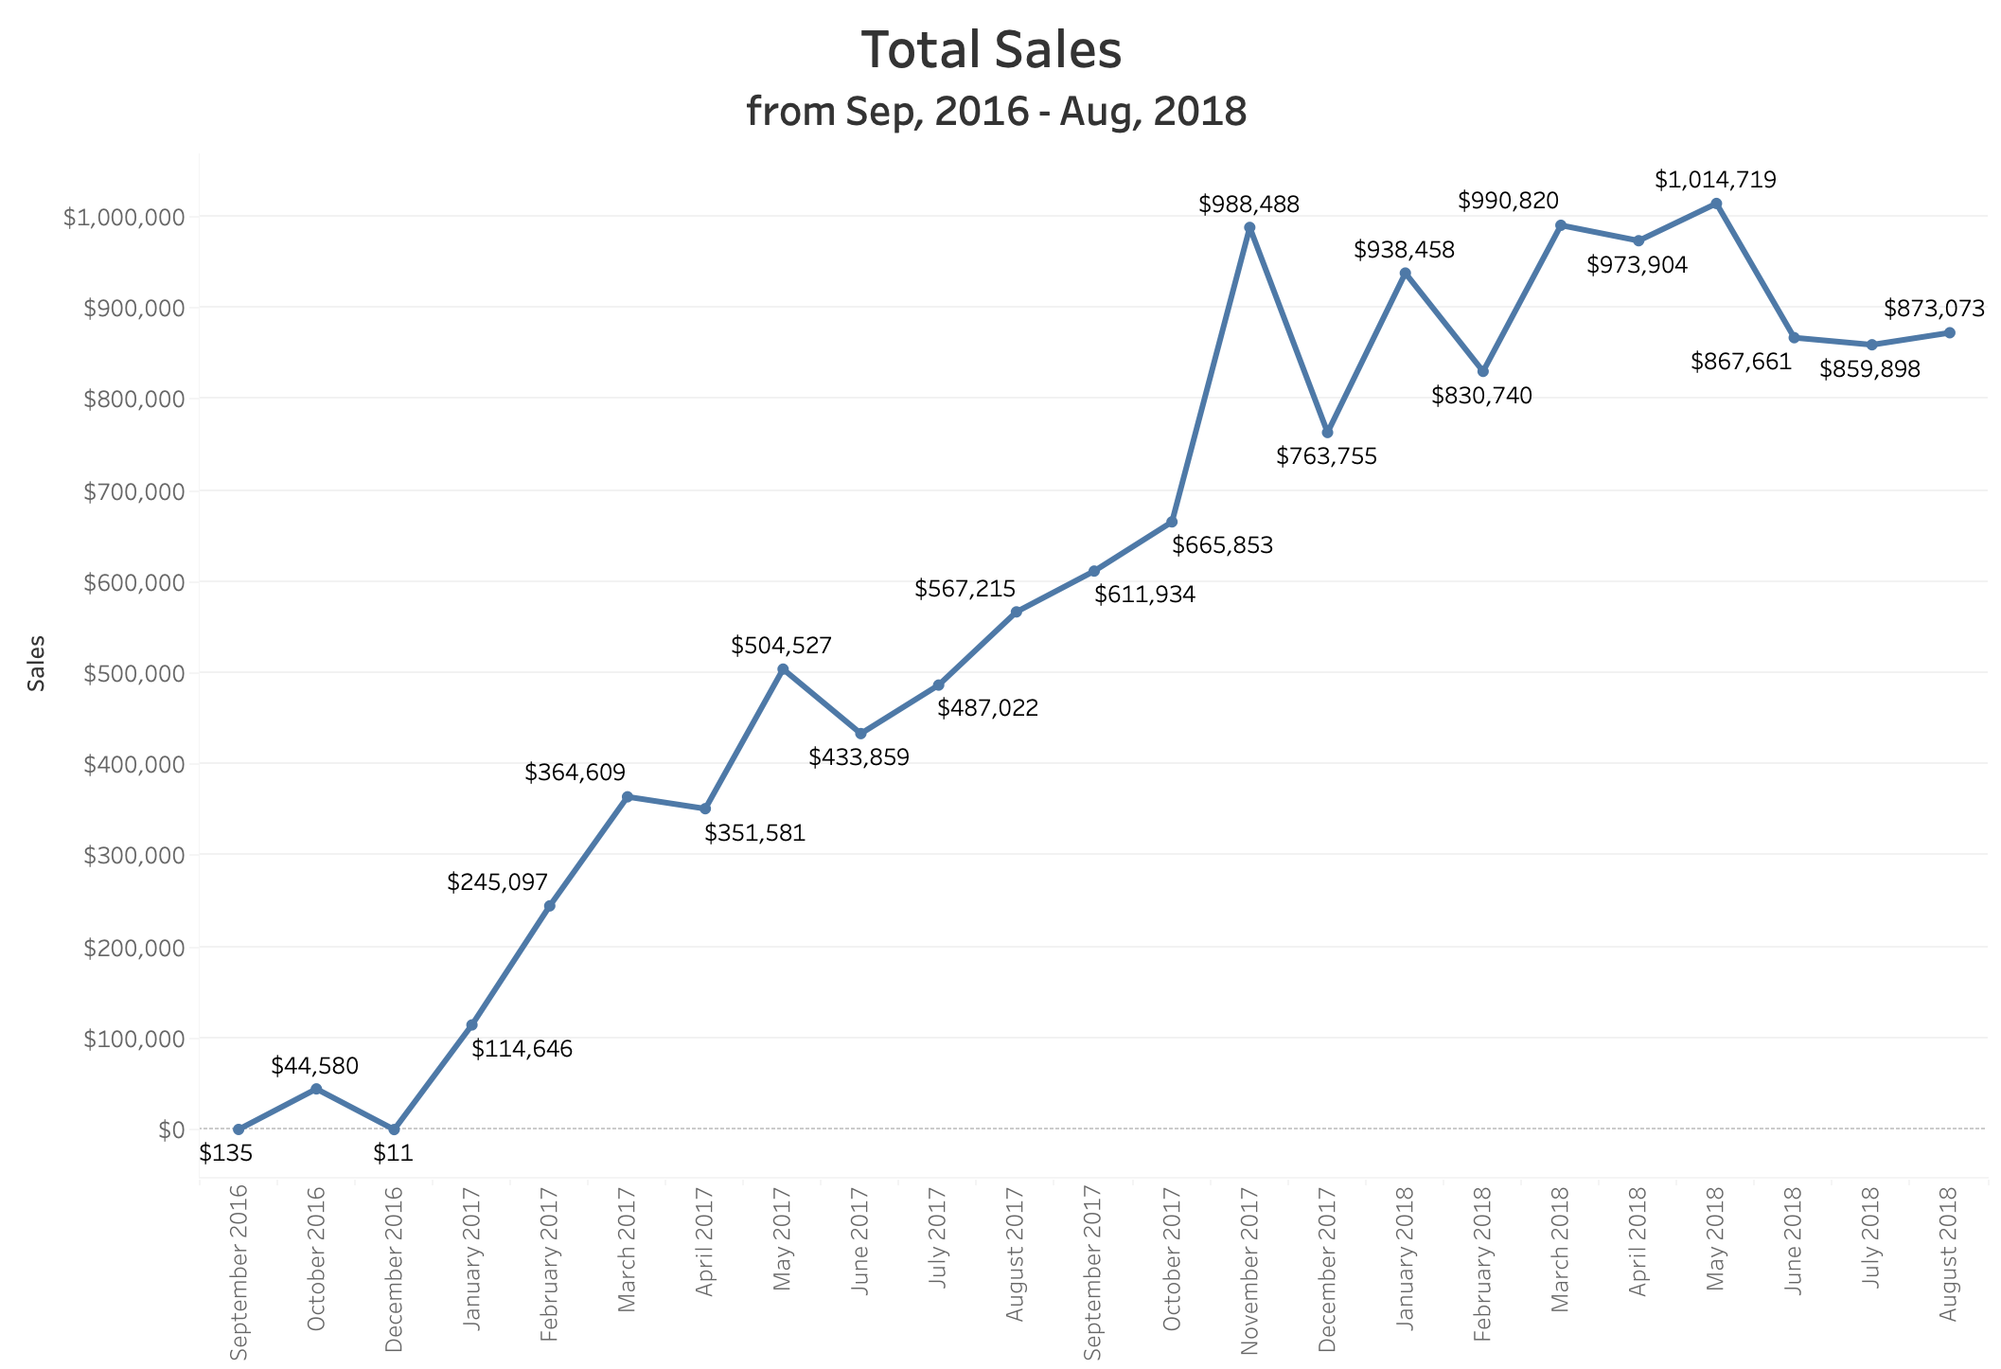
Sales Performance

Slide 9
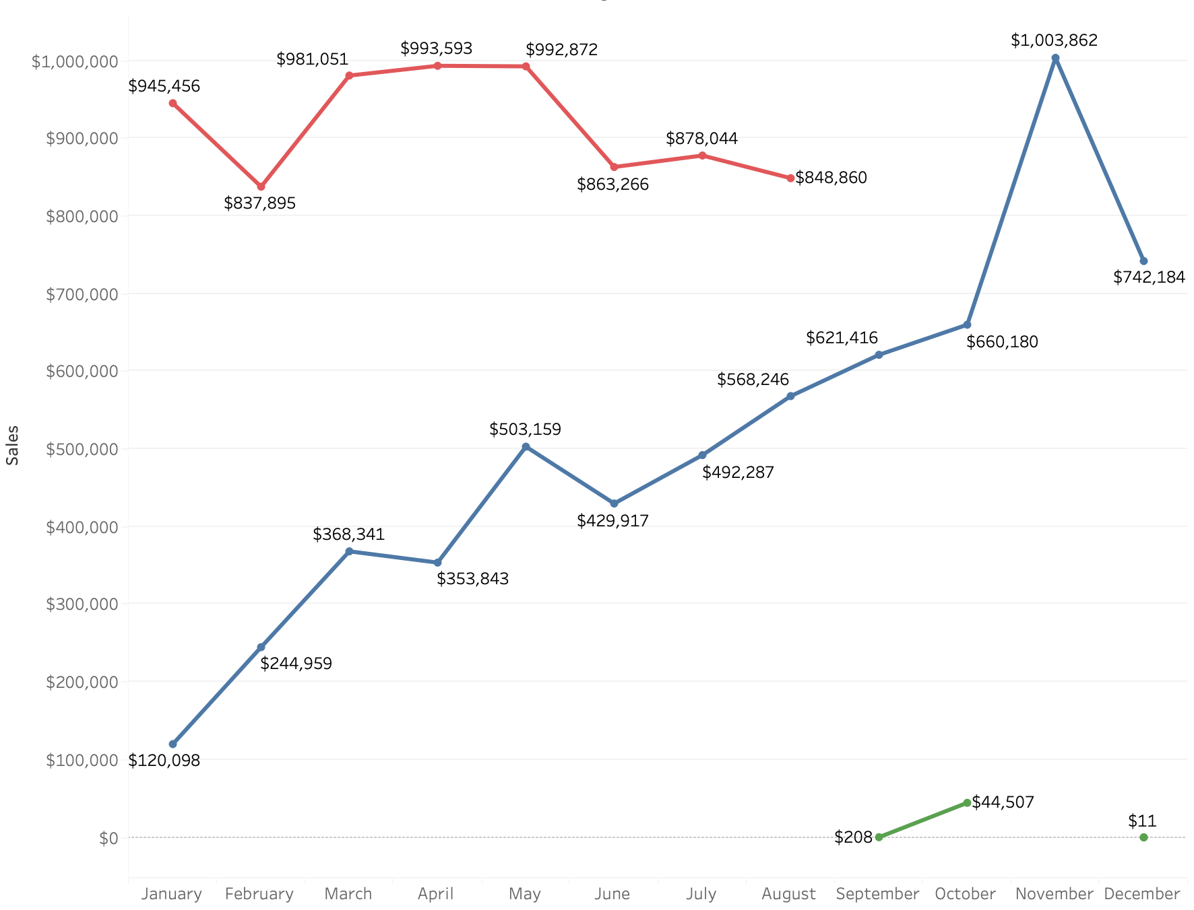
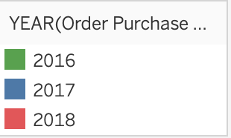
Sales by Year
Monthly Growth: 52%

Slide 10
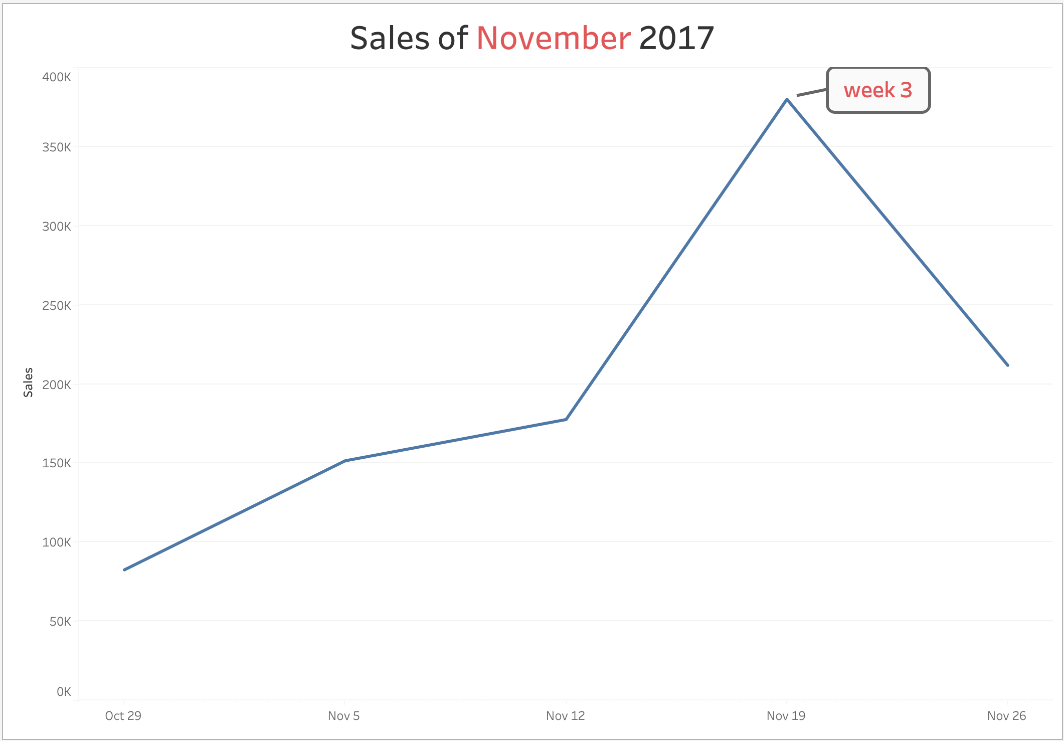
Highest Monthly Sales

Slide 11
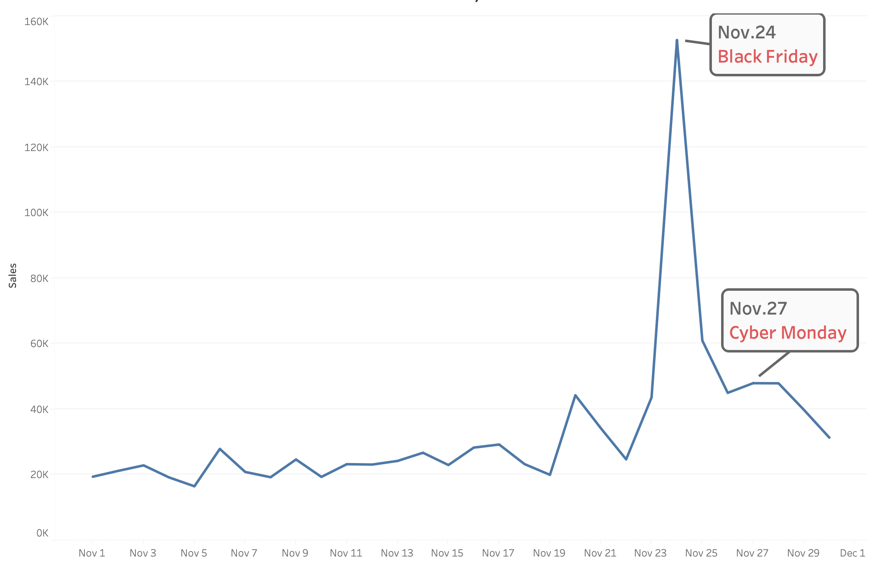
Special Festivals

Slide 12
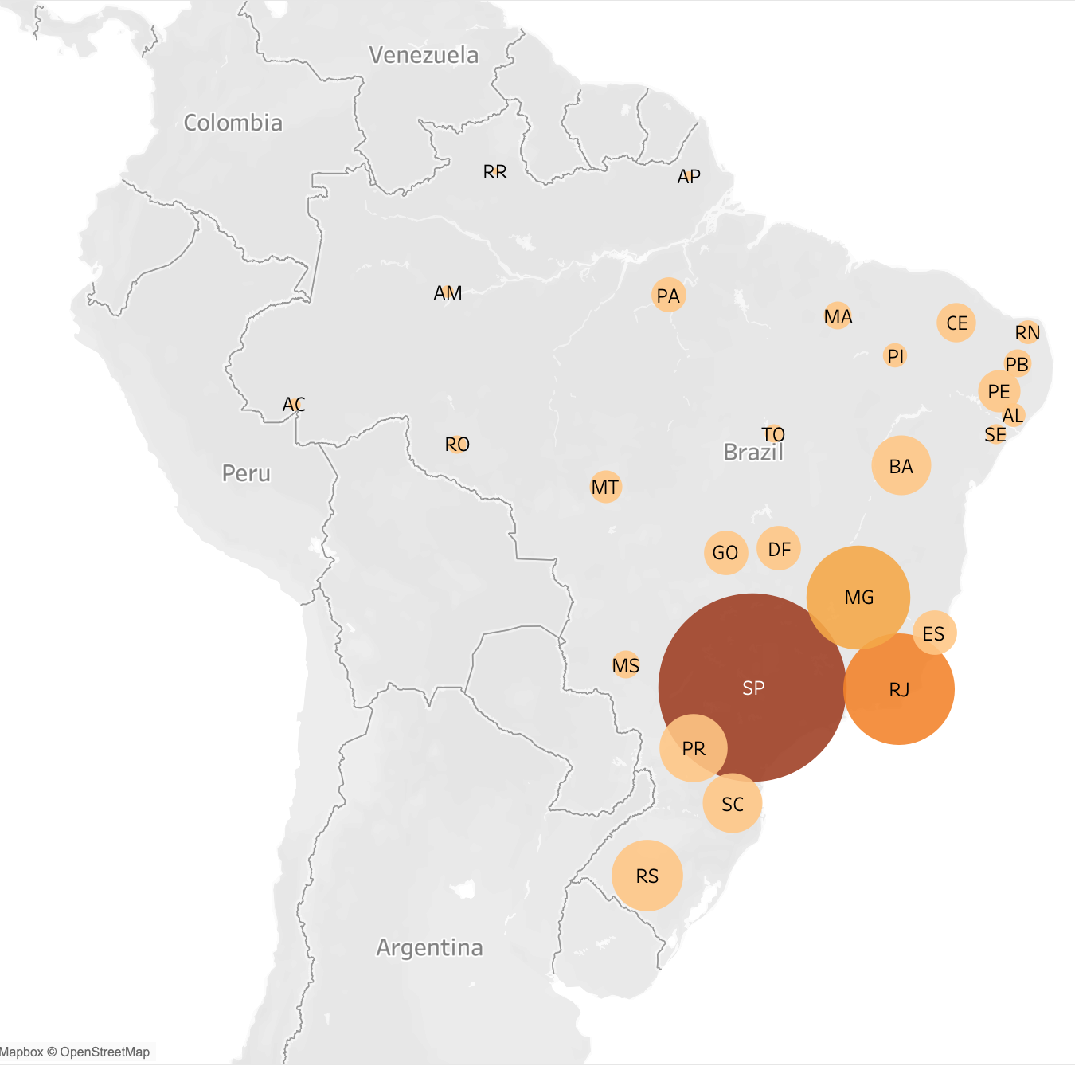
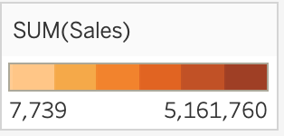
Sales Distribution
SP
Largest population of State
in Brazil/ Americas
RJ
High population density
MG
Second population of State
in Brazil
Notes:
MG：米納斯吉拉斯州，巴西人口第二大州

Slide 13
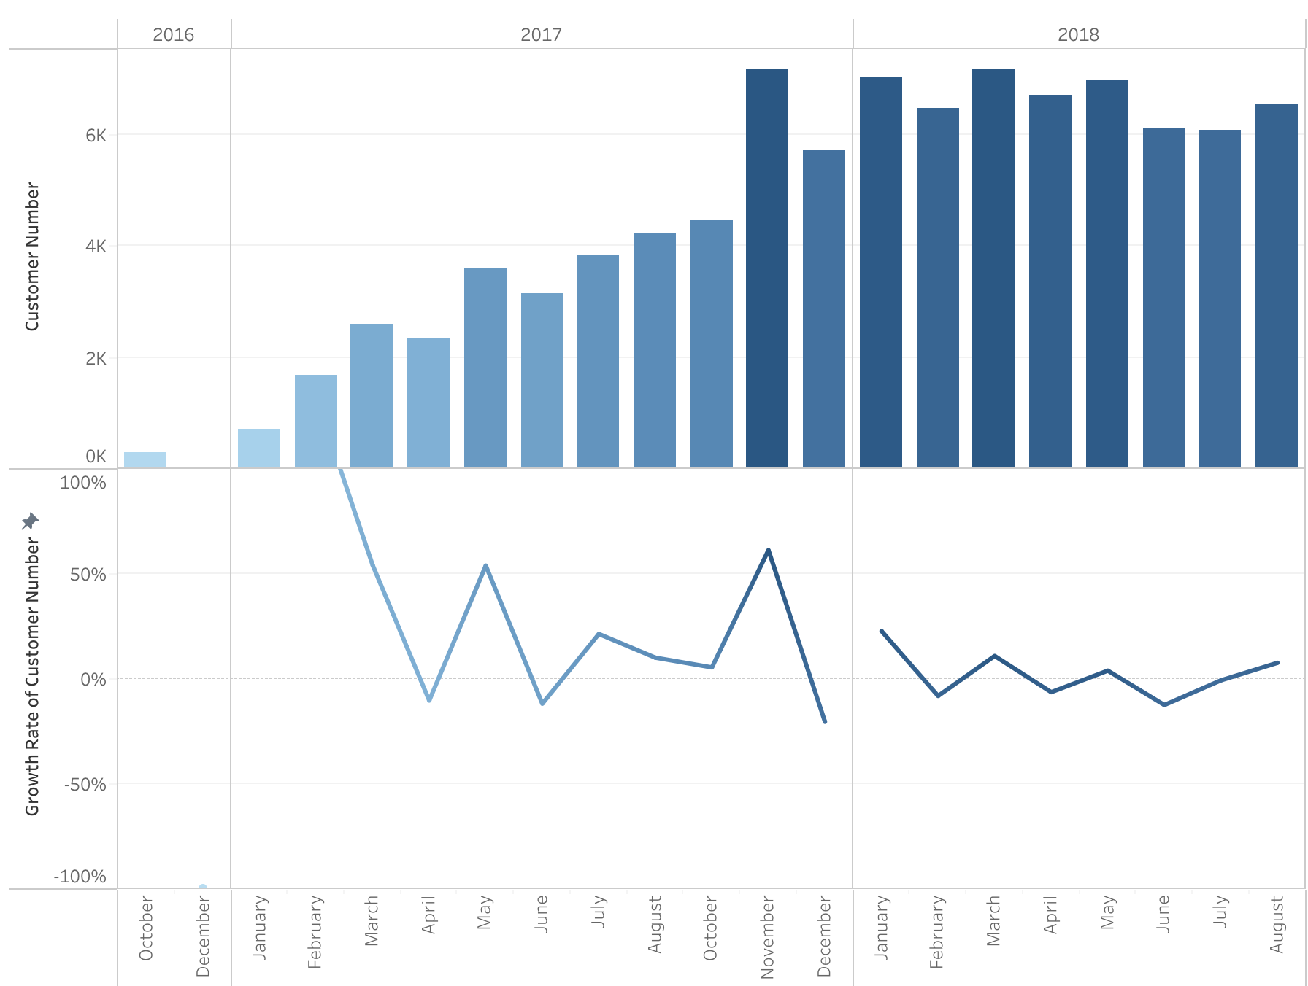
Customers Trend
Customer
Number
Growth
Rate

Slide 14
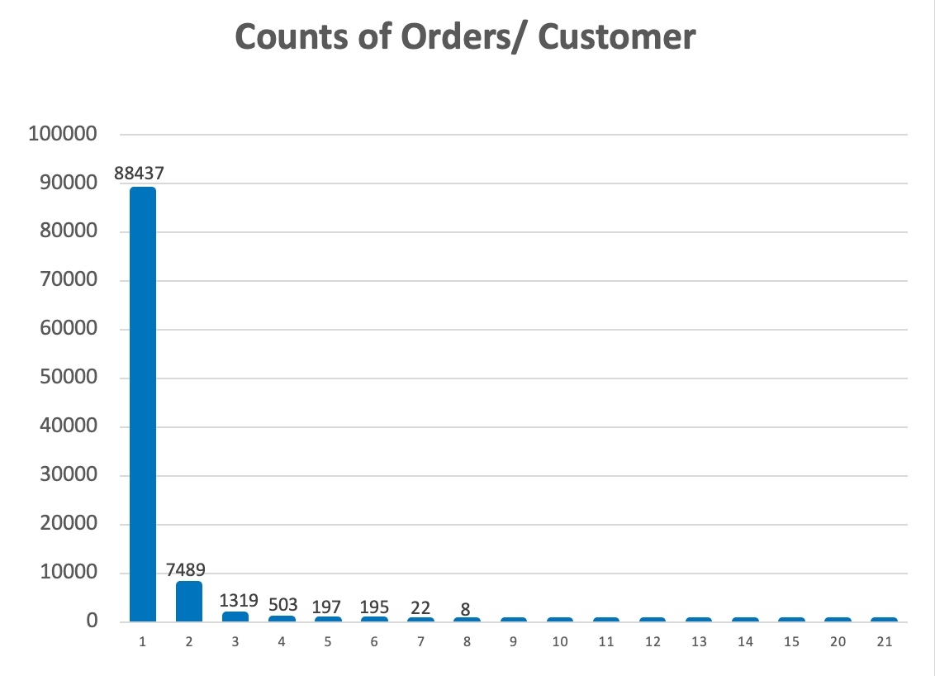
High Customer Churn Rate
Counts of customer_unique_id = 99,441
Customer Number
Counts of Orders

Slide 15
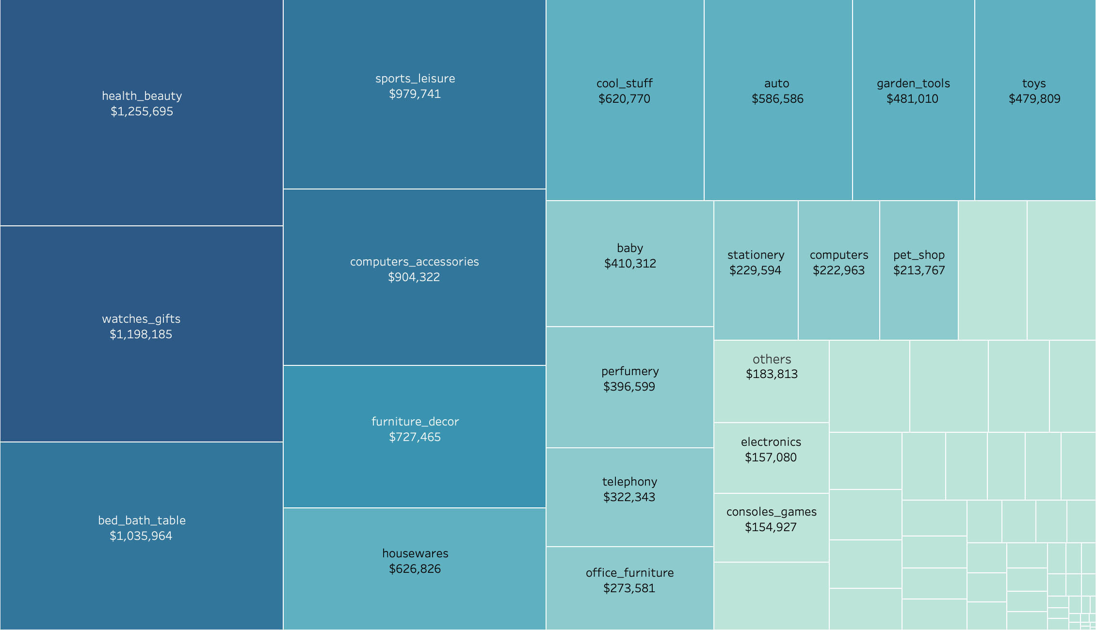
Best Sellers (product category)

Slide 16
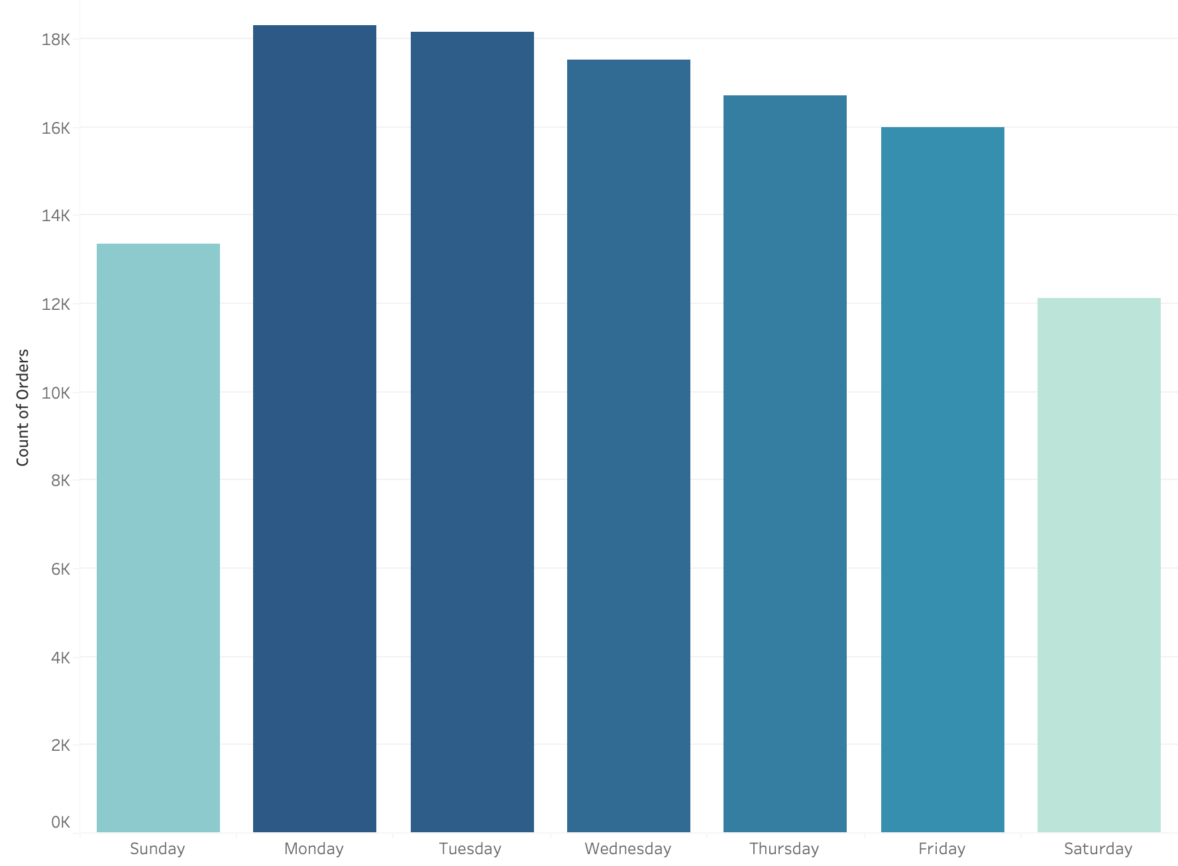
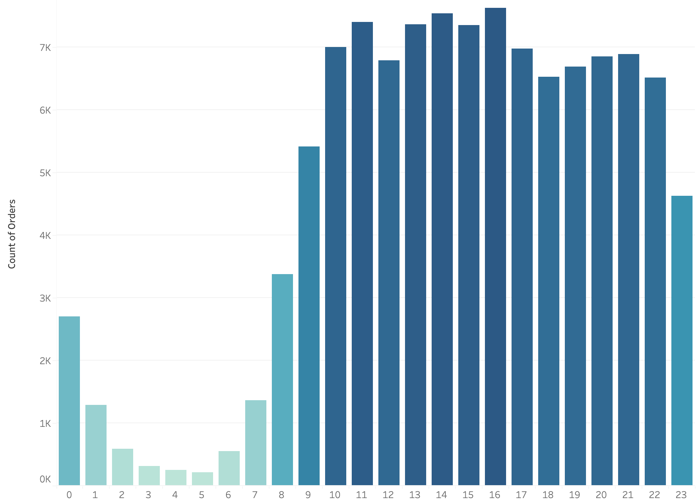
Order Timing
Weekdays/ week
13-16 p.m./ day

Slide 17
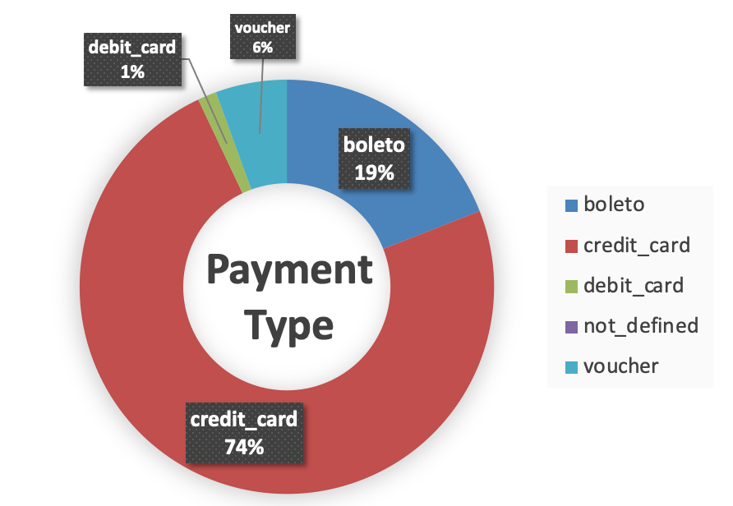
Payment Type
boleto
popular payment type in Brazil
physical or online payment
simplify payment (does not need credit cards)
merchants can accept payments with bank guarantees

Slide 18
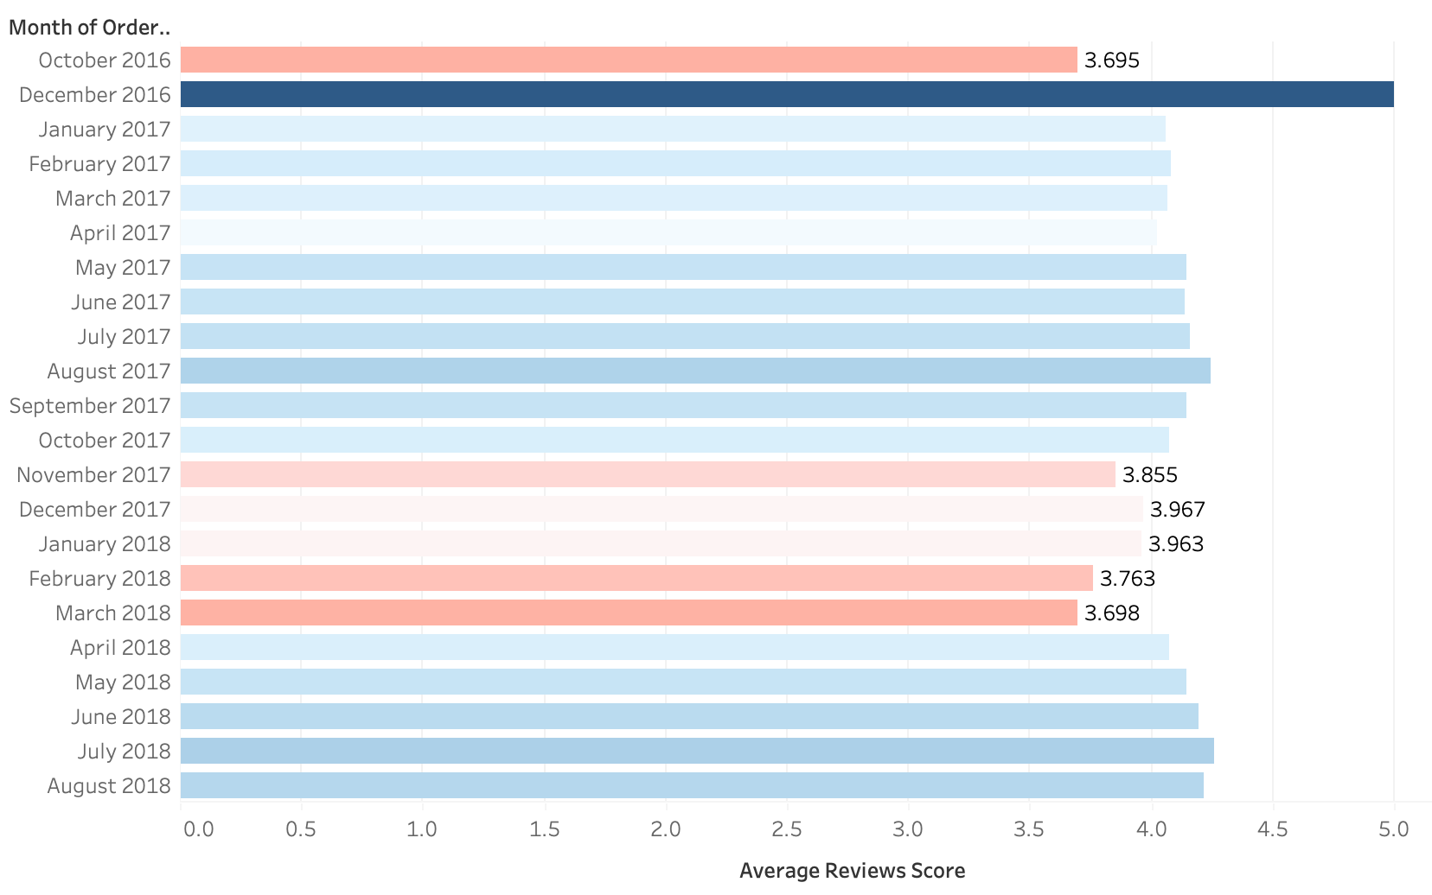
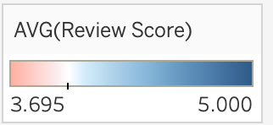
Average Reviews Score
reviews score < 4: 2017-11~2018 Q1

Slide 19
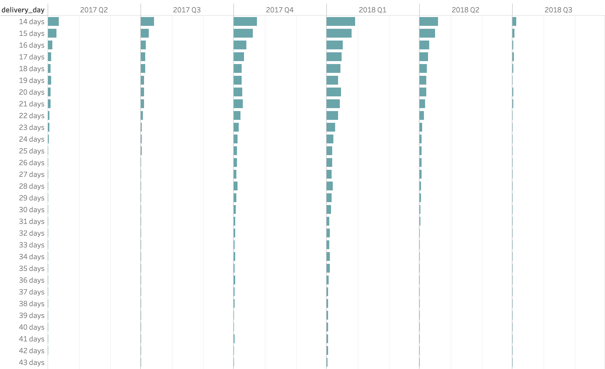
Possible Cause of Low Score
2017 Q4
2018 Q1
Reviews Score < 4: 2017-11~2018 Q1
More orders’ delivery day > 14 days:

Slide 20
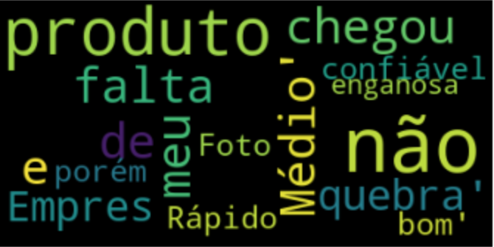
Reviews Comment
from reviews score = 1 or 2
Products not arrived
Wrong Products
Defective Products
Incomplete Products

Slide 21
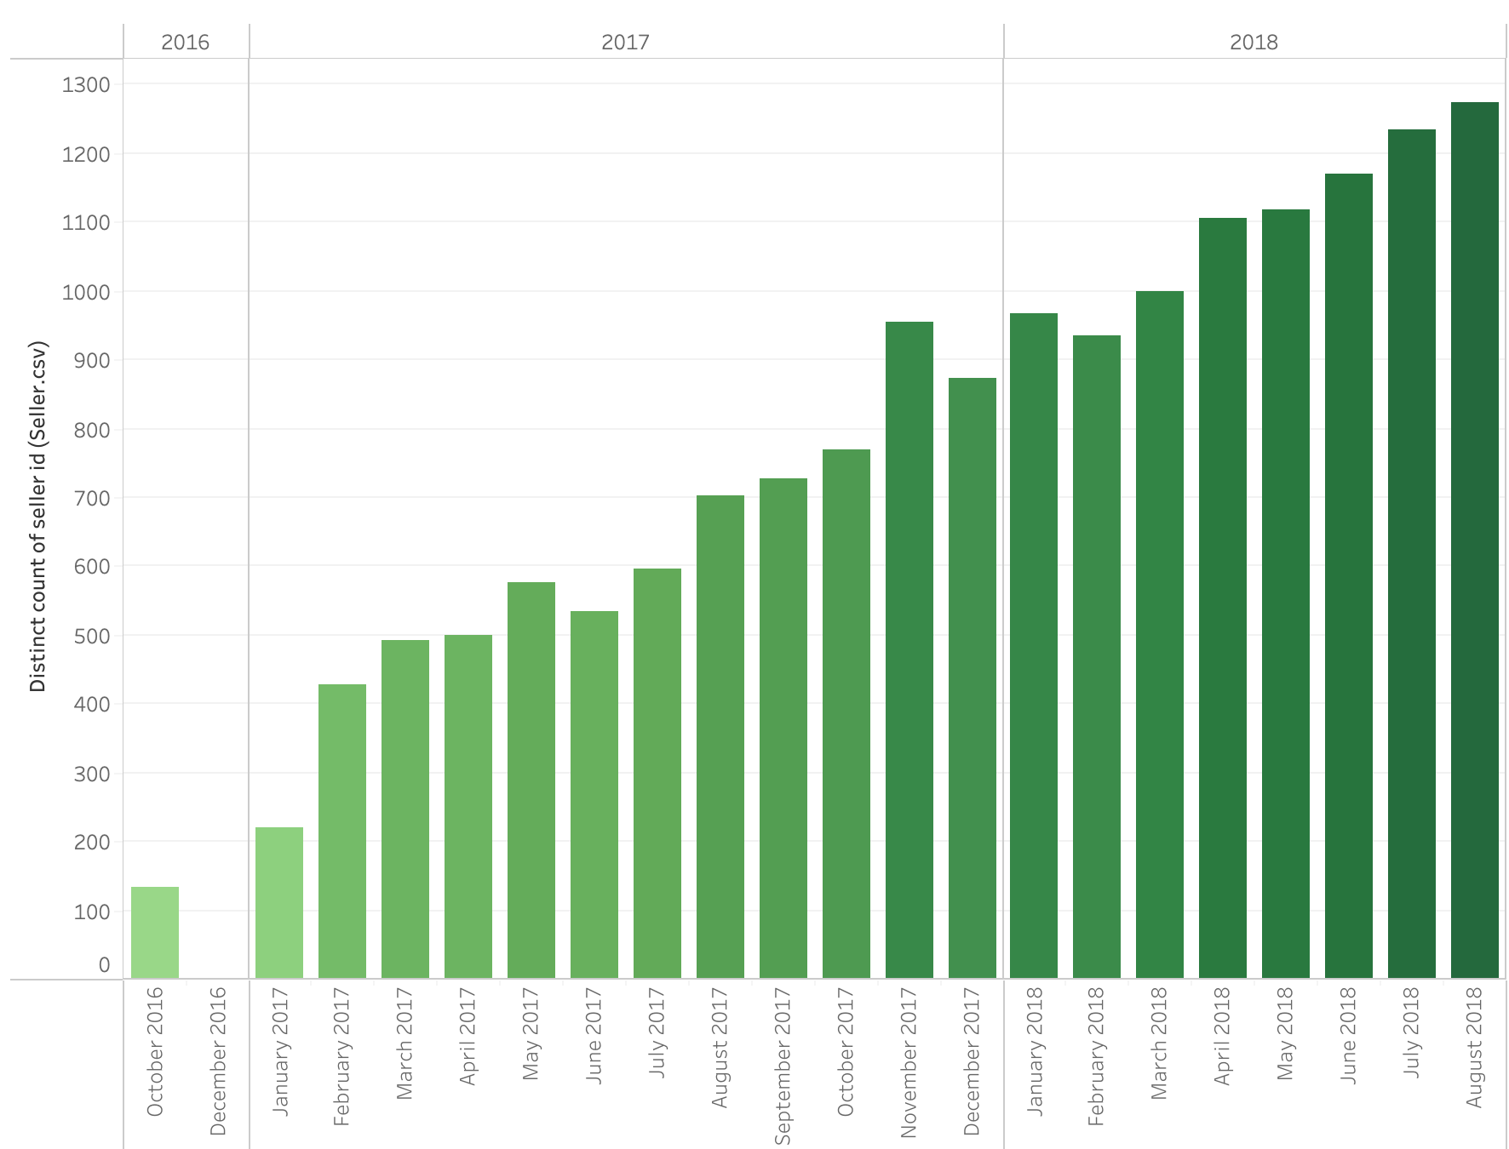
Sellers Trend
Seller
Number

Slide 22
Insight & Suggestion
Steady Rise in Customers (2018) ➞ attract new customers ＆ improve customer retention rate ➞ marketing, expand the market, optimize platform & customer service
Sales Prediction: reach a peak on Nov. ,2018 ➞ get prepared in advance for Black Friday ➞ stress testing, improve delivery efficiency
Promote flash sales on weekends ➞ boost sales on weekends
Manage seller relationships ➞ more efficient operations

Slide 23
Future Work
Customers who ordered more than twice
Customer preference of different state
Relationship of unit price & total sales (each category)

Slide 24
THANKS FOR YOUR TIME

